Slide 1
Object-Oriented Analysis and Design
7.<number>

Slide 2
Introduction
Object-Oriented systems development life cycle
  Process of progressively developing representation of a system component (or object) through the phases of analysis, design and implementation
  The model is abstract in the early stages
  As the model evolves, it becomes more and more detailed
7.<number>

Slide 3
The Object-Oriented Systems Development Life Cycle
Analysis Phase
  Model of the real-world application is developed showing its important properties
  Model specifies the functional behavior of the system independent of implementation details
Design Phase
  Analysis model is refined and adapted to the environment
  Can be separated into two stages
    System design
      Concerned with overall system architecture
    Object design
      Implementation details are added to system design
7.<number>

Slide 4
The Object-Oriented Systems Development Life Cycle
Implementation Phase
  Design is implemented using a programming language or database management system
7.<number>

Slide 5
The Unified Modeling Language (UML)
A notation that allows the modeler to specify, visualize and construct the artifacts of software systems, as well as business models
Techniques and notations
  Use cases
  Class diagrams
  State diagrams
  Sequence diagrams
  Activity diagrams
7.<number>

Slide 6
Use-Case Modeling
Applied to analyze functional requirements of the system
Performed during the analysis phase to help developers understand functional requirements of the system without regard for implementation details
Use Case
  A complete sequence of related actions initiated by an actor
Actor
  An external entity that interacts with the system
7.<number>

Slide 7
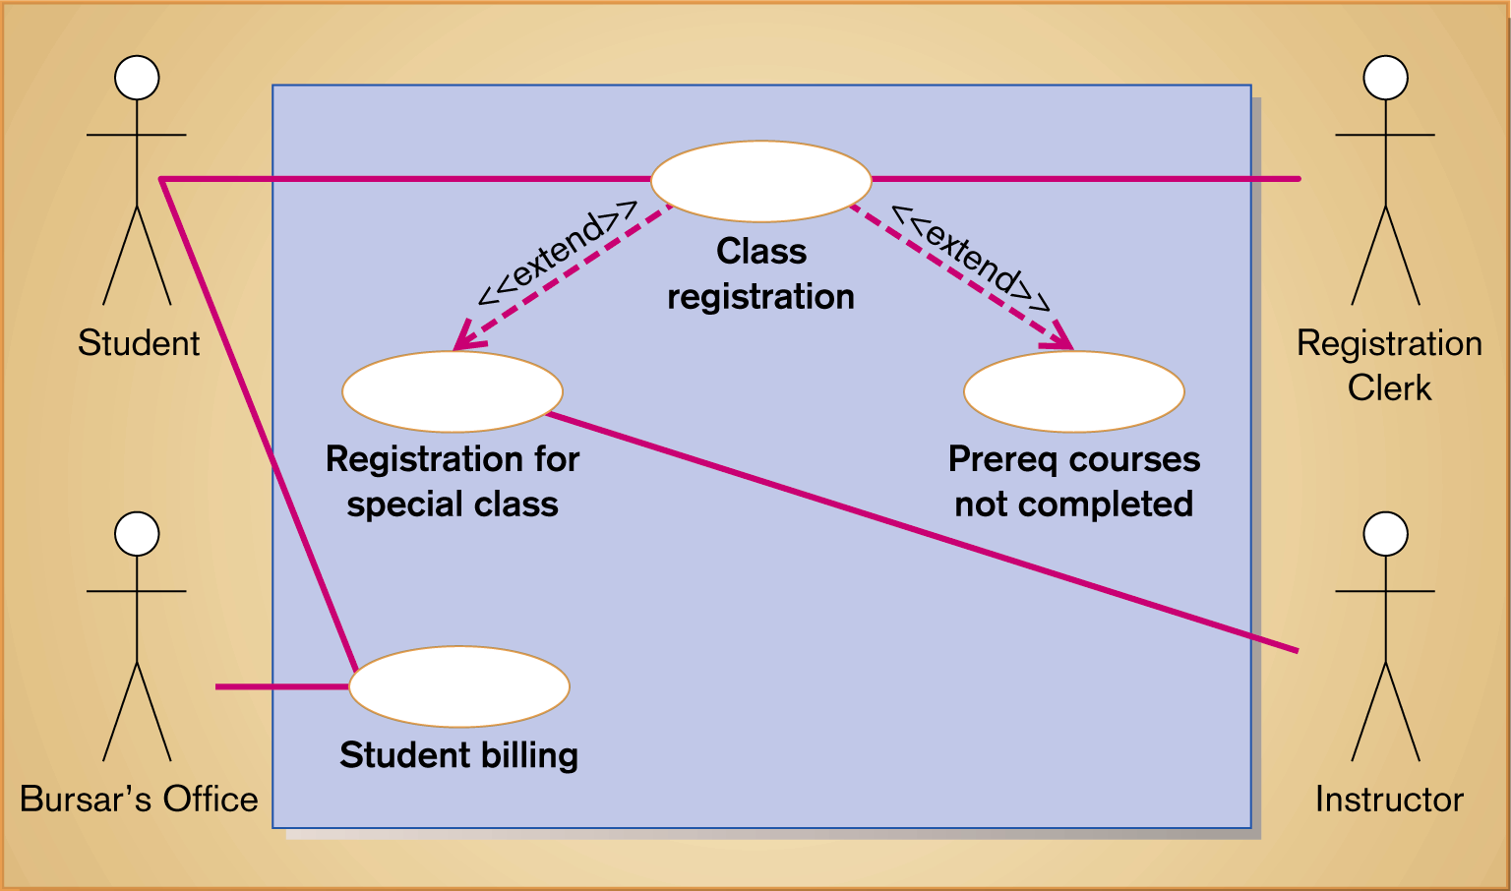
Use-case diagram for a university registration system
7.<number>

Slide 8
Use-Case Modeling
Developing Use-Case Diagrams
  Use cases are always initiated by an actor
  Use cases represent complete functionality of the system
Relationships Between Use Cases
  Use cases may participate in relationships with other use-cases
  Two types
    Extends
      Adds new behaviors or actions to a use case
    Include
      One use case references another use case
7.<number>

Slide 9
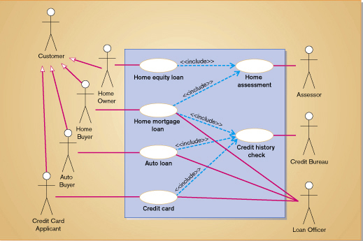

Slide 10
Object Modeling
Class Diagrams
Object
  An entity that has a well-defined role in the application domain, and has state, behavior, and identity
State
  A condition that encompasses an object’s properties and the values those properties have
Behavior
  A manner that represents how an object acts and reacts
Object Class
  A set of objects that share a common structure and a common behavior
7.<number>

Slide 11
Object Modeling
Class Diagrams
Class Diagram
  Class is represented as a rectangle with three compartments
  Objects can participate in relationships with objects of the same class
7.<number>

Slide 12
Object Modeling
Object Diagrams
Object Diagram
  A graph of instances that are compatible with a given class diagram; also called an instance diagram
  Object is represented as a rectangle with two compartments
Operation
  A function or service that is provided by all the instances of a class
Encapsulation
  The technique of hiding the internal implementation details of an object from its external view
7.<number>

Slide 13
Object Modeling
Object Diagrams
Types of Operations
  Query
    An operation that accesses the state of an object but does not alter the state
  Update
    An operation that alters the state of an object
  Scope
    An operation that applies to a class rather than an object instance
  Constructor
    An operation that creates a new instance of a class
7.<number>

Slide 14
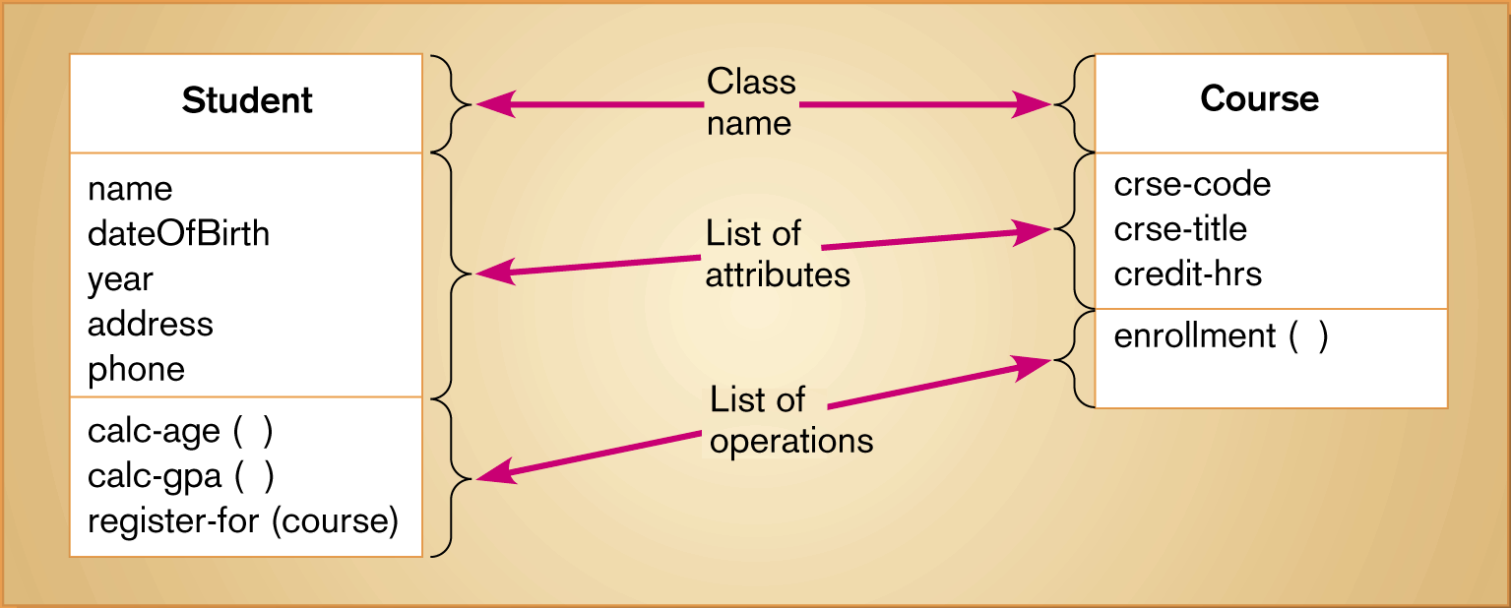
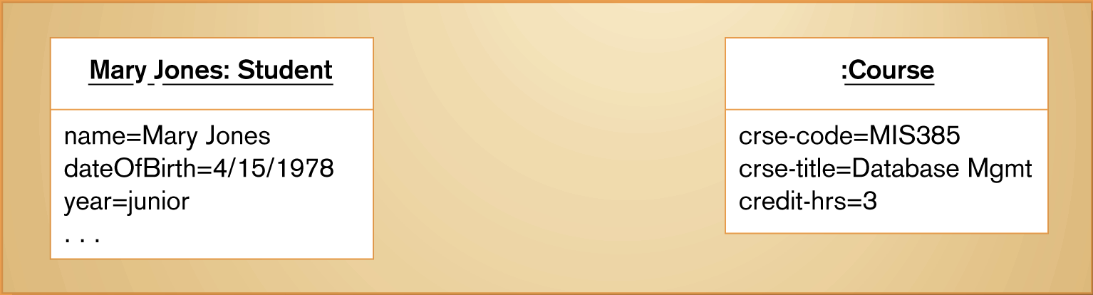
UML class and object diagrams
(a) Class diagram showing two classes
(b) Object diagram with two instances
7.<number>

Slide 15
Representing Associations
Association
  A relationship between object classes
  Degree may be unary, binary, ternary or higher
  Depicted as a solid line between participating classes
Association Role
  The end of an association where it connects to a class
  Each role has multiplicity, which indicates how many objects participate in a given association relationship
7.<number>

Slide 16
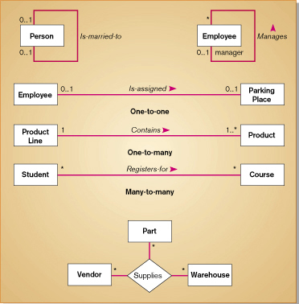

Slide 17
Representing Association Classes
Association Class
  An association that has attributes or operations of its own, or that participates in relationships with other classes
Similar to an associative entity in ER modeling
7.<number>

Slide 18
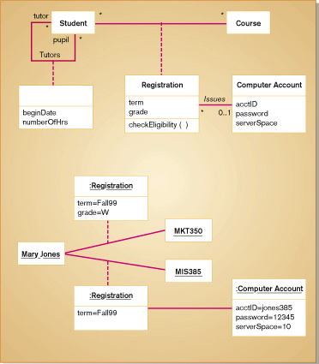

Slide 19
Representing Derived Attributes, Derived Associations and Derived Roles
Derived attributes, associations and roles can be computed from other attributes, associations or roles
Shown by placing a slash (/) before the name of the element
7.<number>

Slide 20
Representing Generalization
Generalization
  Abstraction of common features among multiple classes, as well as their relationships, into a more general class
Subclass
  A class that has been generalized
Superclass
  A class that is composed of several generalized subclasses
7.<number>

Slide 21
Representing Generalization
Discriminator
  Indicate the basis of a generalization by specifying it next to the path in the generalization.
Inheritance
  A property that a subclass inherits the features from its superclass
Abstract Class
  A class that has no direct instances, but whose descendents may have direct instances
Concrete Class
  A class that can have direct instances
7.<number>

Slide 22
Representing Generalization
Semantic Constraints among Subclasses
  Overlapping
    An object can belong more than one subclass.
  Disjoint
    An object can belong to only one subclass.
  Complete
    The subclasses listed contain all possible objects that belong to the superclass.
    No additional subclasses are expected.
  Incomplete
    The subclasses listed does not contain all possible objects that belong to the superclass.
    Some subclasses have been specified.
7.<number>

Slide 23
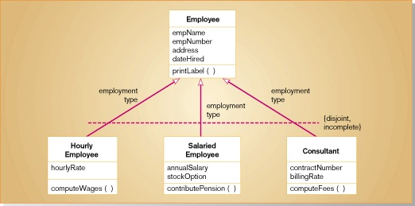

Slide 24
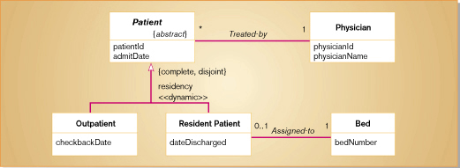

Slide 25
Representing Generalization
Class-scope Attribute
  An attribute of a class which specifies a value common to an entire class, rather than a specific value for an instance.
Abstract Operation
  Defines the form or protocol of an operation but not its implementation
Method
  The implementation of an operation
Polymorphism
  The same operation may apply to two or more classes in different ways
7.<number>

Slide 26
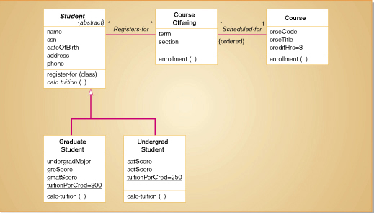

Slide 27
Interpreting Inheritance and Overriding
Overriding
  Process of replacing a method inherited from a superclass by a more specific implementation of that method in a subclass
  Three Types
    Overriding for Extension
      Operation inherited by a subclass from its superclass is extended by adding some behavior
    Overriding for restriction
      The protocol of the new operation in the subclass is restricted
    Overriding for optimization
      The new operation is implemented with improved code by exploiting the restrictions imposed by a subclass
7.<number>

Slide 28
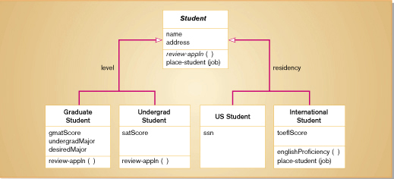

Slide 29
Representing Multiple Inheritance
Multiple Classification
  An object is an instance of more than one class
  Use is discouraged and not supported by UML semantics
Multiple Inheritance
  Allows a class to inherit features from more than one superclass
7.<number>

Slide 30
Representing Aggregation
Aggregation
  A part-of relationship between a component object and an aggregate object
  Example: Personal computer
    Composed of CPU, Monitor, Keyboard, etc
  Represented with hollow diamond at the aggregate end.
  A solid diamond represents a stronger form of aggregation, known as composition. Here, a part object belongs to only one whole object.
7.<number>

Slide 31
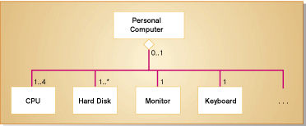
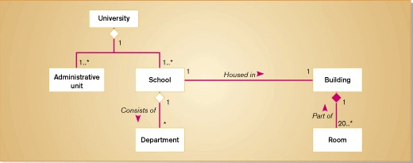

Slide 32
Dynamic Modeling:
State Diagrams
State
  A condition during the life of an object during which it satisfies some conditions, performs some actions or waits for some events
  Shown as a rectangle with rounded corners
State Transition
  The changes in the attribute of an object or in the links an object has with other objects
  Shown as a solid arrow
  Diagrammed with a guard condition and action
Event
  Something that takes place at a certain point in time
State Diagram
  A state diagram depicts the various state transitions or changes an object can experience during its lifetime, along with the events that cause those transitions.
7.<number>

Slide 33
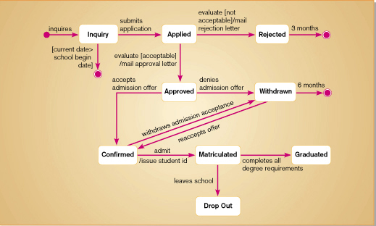
Fig: State diagram for student object

Slide 34
Dynamic Modeling:
Sequence Diagrams
Sequence Diagram
  A depiction of the interaction among objects during certain periods of time
Activation
  The time period during which an object performs an operation
Messages
  Means by which objects communicate with each other
7.<number>

Slide 35
Dynamic Modeling
Sequence Diagrams
Synchronous Message
  A type of message in which the caller has to wait for the receiving object to finish executing the called operation before it can resume execution itself
Asynchronous Message
  A type of message in which the caller does not have to wait for the recipient to handle the message
Simple Message
  A message that transfers control from the sender to the recipient without describing the details of the communication
7.<number>

Slide 36
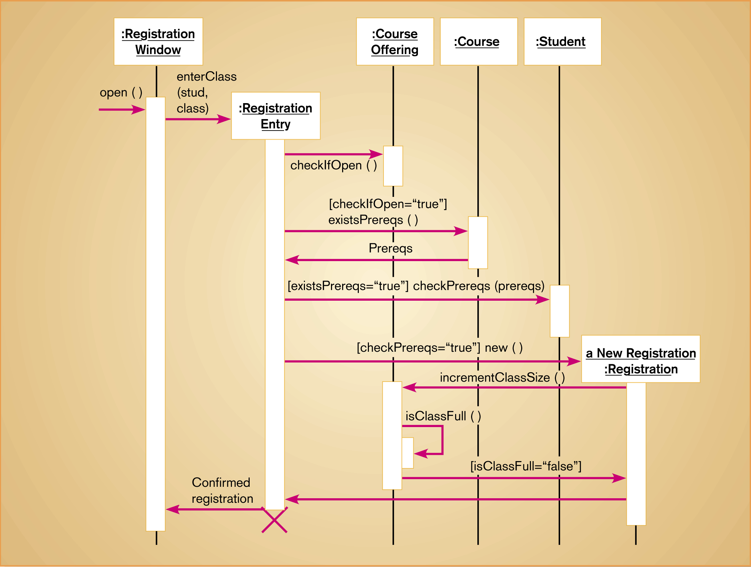
Sequence diagram for a class registration scenario with prerequisites
7.<number>

Slide 37
Analysis Versus Design
Start with existing set of analysis model
Progressively add technical details to these models to create design models
Design model must be more detailed than analysis model
In addition to these models, there are two other diagrams – component diagram and deployment diagrams – that are pertinent during the design phase.
Component Diagram
  A diagram that shows the software components or modules and their dependencies
Deployment Diagram
  A diagram that shows how the software components, process and objects are deployed into the physical architecture of the system
7.<number>

